Slide 1
CSC 334 – Parallel and Distributed Computing
Instructor: Ms. Muntha Amjad
Lecture# 02: Types of Parallelism

Slide 2
Types of Parallelism
Implicit Parallelism: The compiler, runtime, or system automatically identifies and manages parallelism without requiring the programmer to explicitly define it.
Explicit Parallelism: The programmer directly specifies the parallelism, defining threads, synchronization, and communication.

Slide 3
Explicit Parallelism
A programming approach where the developer explicitly instructs the system where and how to parallelize operations using dedicated language features like operators, function calls, or directives.
Since multiple threads are executing concurrently, explicit synchronization mechanisms like barrier or locks are often required to ensure data consistency.
Examples of explicit parallelism techniques
  Data parallelism
  Task parallelism
  Loop-level parallelism
  Thread-based parallelism

Slide 4
Data Parallelism
Applying the same operation to large datasets in parallel, often using loops to iterate through data chunks. The same code segment runs concurrently on each processor, but each processor is assigned its own part of the data to work on.
  For loops define the parallelism.
  The iterations must be independent of each other.
  Data parallelism is called "fine grain parallelism" because the computational work is spread into many small subtasks.

Slide 5
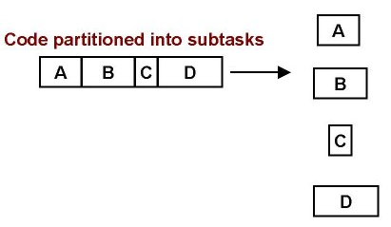
Task Parallelism
As the opposite of data parallelism, task parallelism breaks down a problem into independent tasks that can be executed concurrently on different processors. Different operations are performed on different parts of the data.
  Task parallelism is called "coarse grain" parallelism because the computational work is spread into just a few subtasks.
  More code is run in parallel because the parallelism is implemented at a higher level than in data parallelism.
  Easier to implement and has less overhead than data parallelism.
Example: an image (like color channels) are processed in parallel using separate threads, effectively treating each color channel as a separate task.

Slide 6
Loop-Level Parallelism
Parallelizing operations within loops where each iteration can be executed independently
Loop-level parallelism is a specific technique often used to achieve data parallelism, but data parallelism encompasses a wider range of strategies.
Example:
#pragma omp parallel for
for (int i = 0; i < n; i++)
  a[i] = b[i] + c[i];

Slide 7
Thread-Level Parallelism
Deals with the execution of multiple threads within a program to execute different parts of the code simultaneously. The programmer explicitly creates and manages threads that run concurrently.
Thread-level parallelism is a mechanism for achieving task parallelism by managing threads, but not all task parallelism requires explicit thread management.
Example: A web server using multiple threads to handle incoming requests simultaneously, where each thread processes a single request independently.

Slide 8
Implicit Parallelism
The compiler, runtime, or system automatically identifies and manages parallelism without requiring the programmer to explicitly define it.
Examples of implicit parallelism techniques
  Instruction-Level Parallelism (ILP)
  Compiler-Driven Parallelism

Slide 9
Instruction Level Parallelism
Instruction Level Parallelism (ILP) is a set of techniques for executing multiple instructions at the same time within the same CPU core (Note: ILP has nothing to do with multicore)
Basic Idea: Execute several instructions in parallel; i.e., overlap the execution of instructions to run programs faster (“to improve performance”)
The Problem: A CPU core has a lot of circuits, but at any given moment, many parts remain idle. This wastes processing power..
The solution: Different parts of the CPU core work on different instructions simultaneously instead of waiting for one instruction to finish before starting the next. If a CPU can handle 10 operations at once, a program could run up to 10 times faster—though, in reality, the speedup is usually lower.

Slide 10
Examples of Instruction Level Parallelism
Pipelining: Start performing an operation on one piece of data while finishing the same operation on another piece of data – perform different stages of the same INSTRUCTION on different sets of operands at the same time (like an assembly line). Example: While adding two numbers, the CPU can start preparing the next addition before finishing the first.
Superscalar: The CPU can execute multiple different instructions at the same time. Example: It can add, multiply, and load data simultaneously.
Super-pipelining: This is a mix of superscalar and pipelining—making pipelining even faster. The CPU breaks tasks into smaller steps, allowing multiple steps to run at the same time.
Vectorization: The CPU performs the same operation on multiple data points at once instead of processing them one by one. Example: Adding two lists of numbers in one step instead of adding each number separately.

Slide 11
5 Stages in Executing a MIPS instruction
IF: Instruction Fetch, Increment Program Counter
ID: Instruction Decode, Read Registers
EX: Execution
  Mem-ref: Calculate Address
  Arithmetic/logical: Perform Operation
MEM:
  Load: Read Data from Memory
  Store: Write Data to Memory
WB:
  Write Data Back to Register

Slide 12
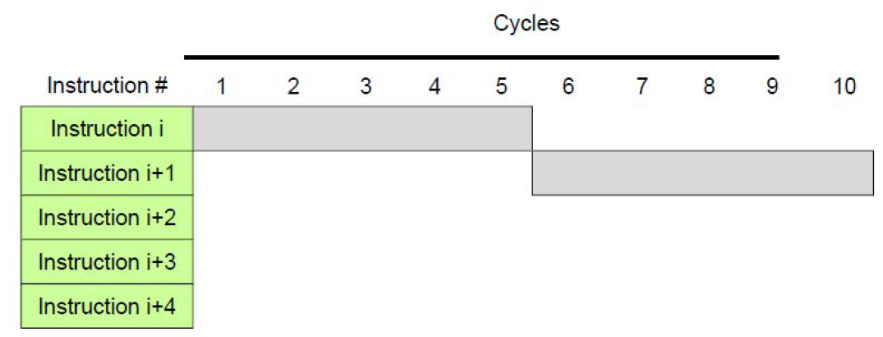
Instruction Execution

Slide 13
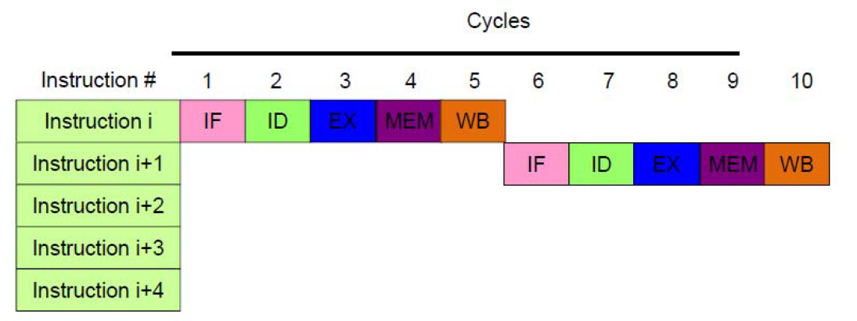
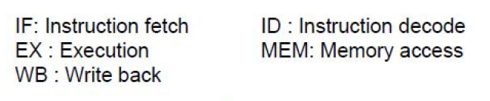
Instruction Execution

Slide 14
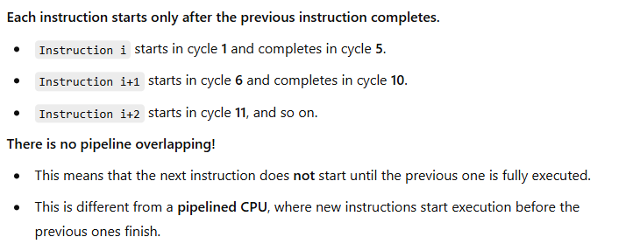
Instruction Execution

Slide 15
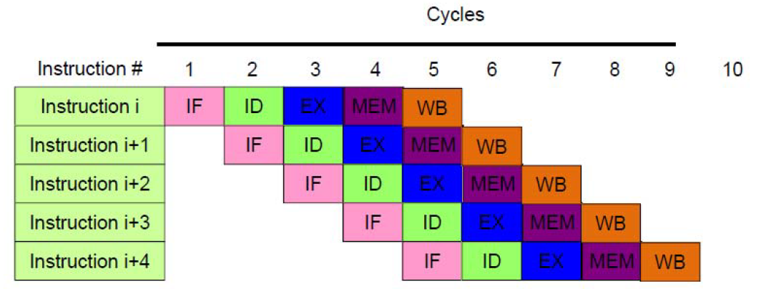
Pipelining Execution

Slide 16
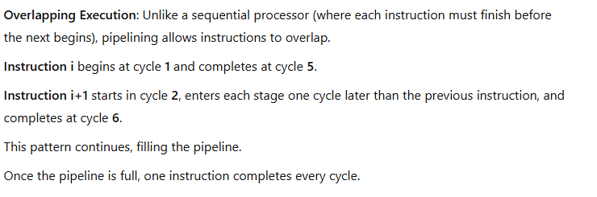
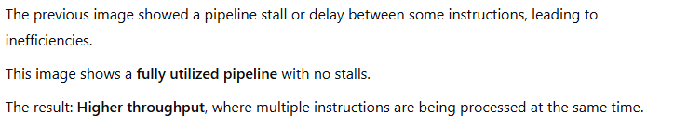
Pipelining Execution

Slide 17
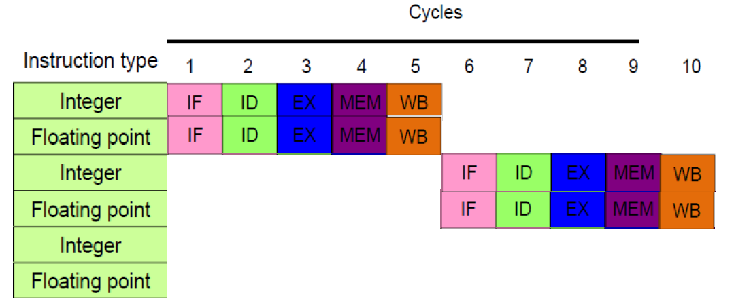
Superscalar Execution

Slide 18
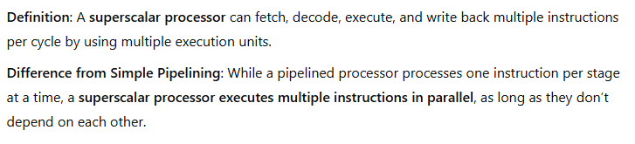
Superscalar Execution

Slide 19
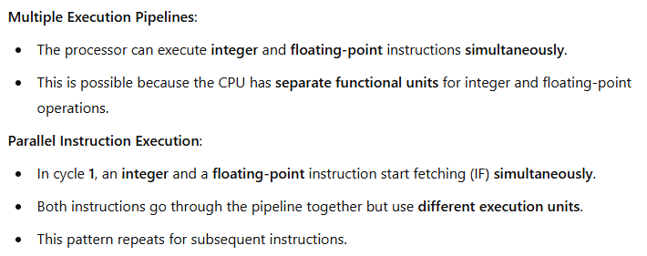
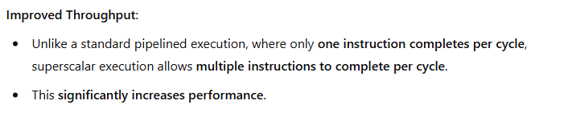
Superscalar Execution

Slide 20
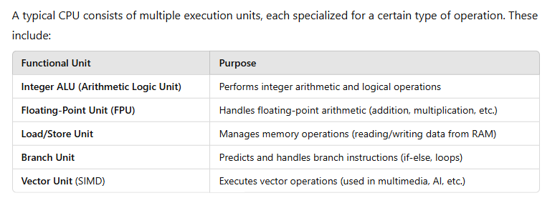
Functional Units in a CPU

Slide 21
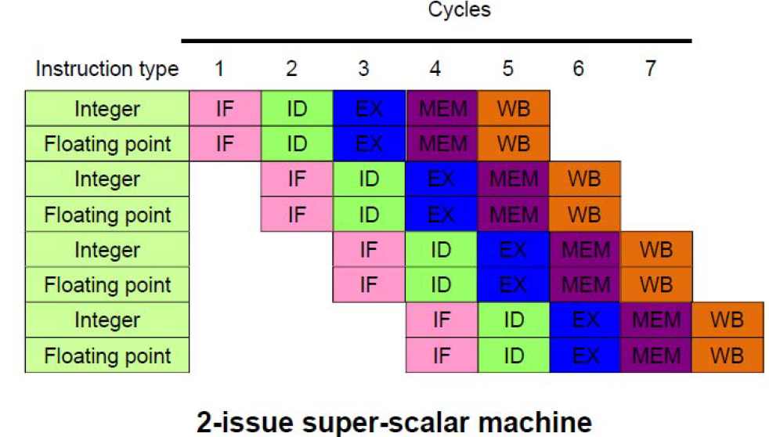
Super-pipelining: Superscalar + Pipeline

Slide 22
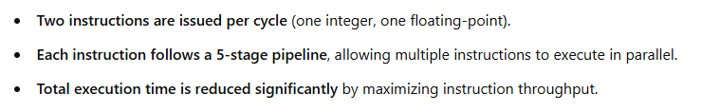
Super-pipelining: Superscalar + Pipeline

Slide 23
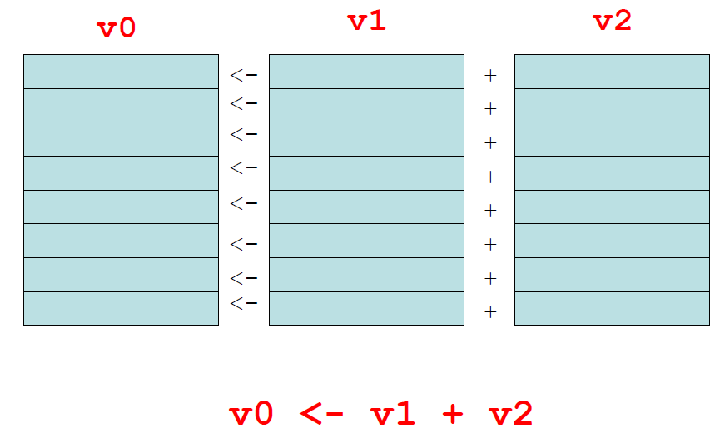
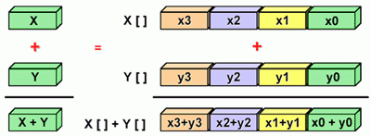
Vectorization
A vector register is a register that’s made up of many individual registers that simultaneously perform the same operation on multiple sets of operands, producing multiple results. In a sense, vectors are like operation-specific cache.
A vector instruction is an instruction that performs the same operation simultaneously on all individual registers of a vector register.
  for(i=0; i <=MAX; i++)
  Z[i] = X[i] + Y[i];

Slide 24
What determines the degree of ILP?
Dependencies: property of the program
Hazards: property of the pipeline
A dependence indicates what program components (statements, loop iterations, etc.) may be executed ignoring the sequence of events specified by the programmer without changing the output. Program components that are not dependent on each other can be executed in parallel.

Slide 25


Types of Dependencies
Data Dependence: When one instruction needs data from a previous instruction before it can execute. The second instruction must wait for the first to finish. (True Dependence)
  RAW: Read-After-Write
Named Dependencies: Write-After-Read (WAR or Anti-Dependance): Happens when an instruction writes to a variable that a previous instruction is still reading. The write to 'y' must wait for the read to finish.

Slide 26


Types of Dependencies
  Write-After-Write (WAW or Output Dependence): Occurs when two instructions write to the same variable. The second write cannot execute before the first completes.
Control Dependence:
  When an instruction depends on a decision (branch/jump) from a previous instruction.
  The second instruction must wait to see if the first condition is true.

Slide 27
What is Dependency Analysis?
It examines how different parts of a program depend on each other.
Ensures that parts of the program execute in the correct order.
Prevents incorrect results due to improper instruction execution.
A key role of modern compilers, which optimize code execution while respecting dependencies.
A data dependency describes how different pieces of data affect each other.
A control dependency describes how instruction sequences affect each other.
Why is this Important?
Compilers analyze dependencies to reorder instructions for better performance.
Parallel execution (in multi-core systems) needs to handle dependencies correctly.
Avoids incorrect calculations due to premature execution of dependent instructions.

Slide 28
Data Dependence and Hazards
If two instructions are data dependent, they cannot execute simultaneously, be completely overlapped or execute in out-of-order
Instruction S2 is data dependent (aka true dependence) on Instruction S1
If data dependence caused a hazard in pipeline, then the hazard is called a Read After Write (RAW) hazard
  S1: X = A + B
  S2: C = X + 1
  S1
  S2

Slide 29
Loop Carried Dependency
Here each iteration of the loop depends on the previous:
  iteration i=3 depends on iteration i=2,
  iteration i=4 depends on iteration i=3,
  iteration i=5 depends on iteration i=4, and so on.
There is no way to execute iteration i until after iteration i-1 has completed, so this loop can’t be parallelized.
  FOR i = 2 to MAX
  a[i] = a[i-1] + b[i]
  END FOR

Slide 30
Why do we care?
Loops are very common in many programs.
Also, it’s easier to optimize loops than more arbitrary sequences of instructions: when a program does the same thing over and over, it’s easier to predict what’s likely to happen next.
Loops are the favorite control structures of High Performance Computing. Both hardware vendors and compiler writers build for optimizing loop performance using instruction-level parallelism (superscalar, pipelining, and vectorization).
Loop carried dependencies affect whether a loop can be parallelized, and how much.

Slide 31
ILP and Data Dependencies, Hazards
HW/SW must preserve program order: code must give the same results as if instructions were executed sequentially in original order of the source program
Importance of the data dependencies:
  Indicates the possibility of a hazard
  Determines order in which results must be calculated
  Sets an upper bound on how much parallelism can possibly be exploited
Goal: Exploit parallelism by preserving program order only where it affects the outcome of the program

Slide 32
Named Dependence and Hazards
Name Dependence: When two instructions use the same variable name (register or memory location), but there is no flow of data between them associated with that variable name.
Anti-Dependence: Instruction S2 writes operand before Instruction S1 reads it
Output-Dependence: Instruction S2 writes operand before Instruction S1 writes it
If anti-dependence caused a hazard in pipeline, then the hazard is called a Write After Read (WAR) hazard
If output-dependence caused a hazard in pipeline, then the hazard is called a Write After Write (WAW) hazard
  S1: A = X + B
  S2: X = C + D
  S1
  S2
  S1: X = A + B
  ...
  S2: X = C + D
  S1
  S2

Slide 33
Control Dependencies
Every program has a well-defined flow of control that moves from instruction to instruction. Every instruction is control dependent on some set of branches (if condition, switch case, function calls, I/O), and, in general, these control dependencies must be preserved to preserve program order.
S1 is control dependent on p1, and S2 is control dependent on p2 but not on p1.
Control dependence need not be preserved
  willing to execute instructions that should not have been executed, thereby violating the control dependences, if can do so without affecting correctness of the program
Speculative Execution
  IF p1 THEN
  S1
  IF p2 THEN
  S2

Slide 34
Speculation
Speculative parallelism helps computers run faster by guessing the outcome of decisions (branches) before knowing for sure. If the guess is right, the program runs faster. If it's wrong, the incorrect work is discarded, and the correct path is executed.
How it works?
  Speculation → The processor fetches, issues, and executes instructions as if its guesses about branches (like if-else conditions) were always correct.
  Dynamic Scheduling → The system fetches and issues instructions but doesn't execute them until it's sure they're needed.
Essentially a data flow execution model: Operations execute as soon as their operands are available

Slide 35
Speculation
Types of predictors
  Branch Prediction: Guessing which path (if/else) the program will take.
  Value Prediction: Predicting future values based on past data
  Prefetching (memory access pattern prediction): Predicting which memory locations will be needed soon and loading them early.
Problems & Inefficiencies
  If the guess is incorrect, extra work needs to be undone.
  The system must clear out incorrect guesses, wasting time.
  Making guesses and fixing wrong ones uses more energy.

Slide 36
Limits to Pipelining
Pipelining increases CPU efficiency by overlapping instruction execution, but it has limitations due to hazards. Hazards prevent the next instruction from executing in its designated clock cycle.
Structural hazards: Occur when hardware resources are insufficient, meaning two or more instructions require the same hardware at the same time.
Data hazards: Occur when an instruction depends on the result of a previous instruction that hasn’t finished executing.
Control hazards: Occur when the CPU encounters a branch (conditional or jump) and doesn’t know the correct next instruction to fetch.

Slide 37
Why Does Order Matter?
Dependencies can affect whether we can execute a particular part of the program in parallel.
If we cannot execute that part of the program in parallel, then it’ll be SLOW.

Slide 38
Dependencies in Loops
Dependencies in loops are easy to understand if loops are unrolled. Now the dependences are between statement “instances”
  FOR i = 1 to n
  S1 a[i] = b[i] + 1
  S2 c[i] = a[i] + 2
  Iteration: 1 2 3 4 ...
  Instances of S1:
  ...
  Instances of S2:
  S1
  S2
  S1
  S1
  S2
  S2
  S1
  S2

Slide 39
Dependencies in Loops
A little more complex example
  FOR i = 1 to n
  S1 a[i] = b[i] + 1
  S2 c[i] = a[i-1] + 2
  Iteration: 1 2 3 4 ...
  Instances of S1:
  ...
  Instances of S2:
  S1
  S1
  S2
  S1
  S2
  S2
  S1
  S2

Slide 40
Dependencies in Loops
Even more complex example
  FOR i = 1 to n
  S1 a = b[i] + 1
  S2 c[i] = a + 2
  Iteration: 1 2 3 4 ...
  Instances of S1:
  ...
  Instances of S2:
  S1
  S2
  S1
  S1
  S2
  S2
  S1
  S2

Slide 41
Branch Dependency
The value of y depends on what the condition (x ! = 0) evaluates to:
  If the condition evaluates to TRUE, then y is set to 1.0/x
  Otherwise, y remains 7
  y = 7
  IF (x != 0) THEN
  y = 1.0/x
  END IF

Slide 42
Optimizing with Dependencies
It is valid to parallelize/vectorize a loop if no dependences cross its iteration boundaries:
  FOR i = 1 to n
  S1 a[i] = b[i] + 1
  S2 c[i] = a[i] + 2
    1 2 3 4 ...
  ...
  S1
  S2
  S1
  S1
  S2
  S2
  S1
  S2

Slide 43
Loop or Branch Dependency?
Is this a loop carried dependency or a branch dependency?
  FOR i = 1 to MAX
  IF (x[i] != 0)
  y[i] = 1.0/x[i]
  END IF
  END FOR

Slide 44
Loop or Branch Dependency?
Is this a loop carried dependency or a branch dependency?
  FOR i = 1 to MAX
  IF (x[i] != 0)
  y[i] = 1.0/x[i]
  END IF
  END FOR
Answer:
The given code has a branch dependency due to the conditional (IF x[i] != 0).
However, it does not have a loop-carried dependency since each iteration
is independent.

Slide 45
Compiler-Driven Parallelism
Tricks that compilers play for automatic parallelization
  Scalar optimizations
  Loop-level optimizations

Slide 46
Scalar Optimizations
Copy Propagation
Constant Folding
Dead Code Removal
Strength Reduction
Common Subexpression Elimination
Variable Renaming
Not every compiler does all these, so it sometimes can be worth doing these by hands

Slide 47
Copy Propagation
  x = y
  z = 1 + x
Before
Has data dependency
Compile
  x = y
  z = 1 + y
After
No data dependency

Slide 48
Constant Folding
Before
After
  add = 100
  aug = 200
  sum = add + aug
  sum = 300
Notice that sum is actually the sum of two constants, so the compiler can precalculate it, eliminating the addition that otherwise would be performed at runtime.

Slide 49
Dead Code Removal
Before
After
  var = 5
  PRINT *, var
  STOP
  PRINT *, var * 2
  var = 5
  PRINT *, var
  STOP
Since the last statement never executes, the compiler can eliminate it.

Slide 50
Strength Reduction
Before
After
  x = y^2.0
  a = c / 2.0
  x = y * y
  a = c * 0.5
Raising one value to the power of another, or dividing, is more expensive than multiplying. If the compiler can tell that the power is a small integer, or that the denominator is a constant, it’ll use multiplication instead.

Slide 51
Common Subexpression Elimination
Before
After
  d = c * (a / b)
  e = (a / b) * 2.0
  adivb = a / b
  d = c * adivb
  e = adivb * 2.0
The subexpression (a / b) occurs in both assignment statements, so there’s no point in calculating it twice.
This is typically only worth doing if the common subexpression is expensive to calculate.

Slide 52
Variable Renaming
Before
After
  x = y * z
  q = r + x * 2.0
  x = a + b
  x0 = y * z
  q = r + x0 * 2
  x = a + b
The original code has output dependency, while the new code doesn’t – but the final value of x is still correct.

Slide 53
Loop Optimizations
Hoisting Loop Invariant Code
Unswitching
Iteration Peeling
Index Set Splitting
Loop Interchange
Unrolling
Loop Fusion
Loop Fission
Inlining
Not every compiler does all these, so it sometimes can be worth doing these by hands

Slide 54
Hoisting Loop Invariant Code
The code that does not change inside the loop is known as loop invariant. It doesn’t need to be calculated over and over.
Before
After
  FOR i = 1 to n
  a[i] = b[i] + c * d
  e = g(n)
  END FOR
  temp = c * d
  FOR i = 1 to n
  a[i] = b[i] + temp
  END FOR
  e = g(n)

Slide 55
Unswitching
  FOR i = 1 to n
  FOR j = 2 to n
  IF (t(i) > 0) THEN
  a[i][j] = a[i][j] * t(i) + b(j)
  ELSE
  a[i][j] = 0.0
  END IF
  END FOR
  END FOR
The condition is j-independent
Before
  FOR i = 1 to n
    IF (t(i) > 0) THEN
  FOR j = 2 to n
  a[i][j] = a[i][j] * t(i) + b(j)
  END FOR
  ELSE
  FOR j = 2 to n
  a[i][j] = 0.0
  END FOR
  END IF
  END FOR
So, it can migrate outside the j loop
After

Slide 56
Iteration Peeling
  FOR i = 1 to n
  IF ((i == 1) OR (i == n)) THEN
  x[i] = y[i]
  ELSE
  x[i] = y[I + 1] + y[i - 1]
  END IF
  END FOR
Before
We can eliminate the IF by peeling the weird iterations.
  x(1) = y(1)
  FOR i = 2 to n-1
  x[i] = y[I + 1] + y[i - 1]
  END FOR
  x(n) = y(n)
After

Slide 57
Index Set Splitting
  FOR i = 1 to n
  a[i] = b[i] + c[i]
  IF ((i > 10) THEN
  d[i] = a[i] + b[i – 10]
  END IF
  END FOR
Before
  FOR i = 1 to 10
  a[i] = b[i] + c[i]
  END FOR
  FOR i = 11 to n
  a[i] = b[i] + c[i]
  d[i] = a[i] + b[i - 10]
  END FOR
After
Note that this is a generalization of peeling.

Slide 58
Loop Interchange
Before
After
  FOR i = 1 to nj
  FOR j = 1 to ni
  a[i][j] = b[i][j]
  END FOR
  END FOR
  FOR i = 1 to ni
  FOR j = 1 to nj
  a[i][j] = b[i][j]
  END FOR
  END FOR
The array elements a[i][j] and a[i][j+1] are near each other in memory, while a[i+1][j] may be far, so it makes sense to make the i loop be the outer loop.
This technique facilitates efficient exploitation of the phenomenon of locality of reference.

Slide 59
Unrolling:
  FOR i = 1 to n
  a[i] = a[i] + b[i]
  END FOR
Before
  FOR i = 1, n, 4
  a[i] = a[i] + b[i]
  a[i+1] = a[i+1] + b[i+1]
  a[i+2] = a[i+2] + b[i+2]
  a[i+3] = a[i+3] + b[i+3]
  END FOR
After
You generally shouldn’t unroll by hand.

Slide 60
Why Do Compilers Unroll?
A loop with a lot of operations gets better performance (up to some point), especially if there are lots of arithmetic operations but few main memory loads and stores.
Unrolling creates multiple operations that typically load from the same, or adjacent, cache lines.
So, an unrolled loop has more operations without increasing the memory accesses by much.
Also, unrolling decreases the number of comparisons on the loop counter variable, and the number of branches to the top of the loop.

Slide 61
Loop Fusion
  FOR i = 1 to n
  a[i] = b[i] + 1
  END FOR
  FOR i = 1 to n
  c[i] = a[i] /2
  END FOR
  FOR i = 1 to n
  d[i] = 1 / c[i]
  END FOR
Before
  FOR i = 1, n
  a[i] = b[i] + 1
  c[i] = a[i] / 2
  d[i] = 1 / c[i]
  END FOR
After
As with unrolling, this has fewer branches. It also has fewer total memory references.

Slide 62
Loop Fission
  FOR i = 1, n
  a[i] = b[i] + 1
  c[i] = a[i] / 2
  d[i] = 1 / c[i]
  END FOR
Before
  FOR i = 1 to n
  a[i] = b[i] + 1
  END FOR
  FOR i = 1 to n
  c[i] = a[i] /2
  END FOR
  FOR i = 1 to n
  d[i] = 1 / c[i]
  END FOR
After
Fission reduces the cache footprint and the number of operations per iteration.

Slide 63
To Fuse or to Fizz?
The question of when to perform fusion versus when to perform fission, like many many optimization questions, is highly dependent on the application, the platform and a lot of other issues that get very, very complicated.
Compilers don’t always make the right choices.
That’s why it’s important to examine the actual behavior of the executable.

Slide 64
Inlining
Before
After
  FOR i = 1 to n
  a[i] = func(i)
  END FOR
  int func(x)
  func = x * 3
  RETURN func
  FOR i = 1 to n
  a[i] = i * 3
  END FOR
When a function or subroutine is inlined, its contents are transferred directly into the calling routine, eliminating the overhead of making the call.

Slide 65
Task of the Compiler
It transform program to remove dependencies
Use dependence to reorganize computation for parallelism and locality.
However, manual transformation by hand can sometimes be more useful.

Slide 66
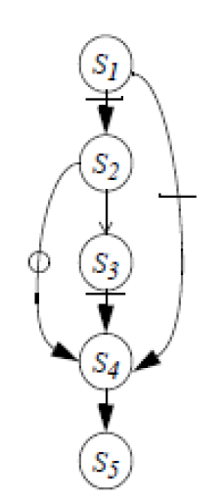
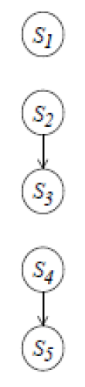
Transforming Programs: Renaming
  S1: A = X + B
  S2: X = Y + 1
  S3: C = X + B
  S4: X = Z + B
  S5: D = X + 1
  S1: A = X + B
  S2: X1 = Y + 1
  S3: C = X1 + B
  S4: X2 = Z + B
  S5: D = X2 + 1

Slide 67
Transform Programs: Scalar Expansion
Scalar expansion is an optimization technique that transforms a loop containing a scalar dependency into an equivalent loop using an array version of the scalar variable. This eliminates dependencies and improves parallelization.
  FOR i = 1 to n
  S1 a = b[i] + 1
  S2 c[i] = a + d[i]
  END FOR
  ...
  S1
  S2
  S1
  S1
  S2
  S2
  S1
  S2
  FOR i = 1 to n
  S1 a1[i] = b[i] + 1
  S2 c[i] = a1[i] + d[i]
  END FOR
  a = a1[n]
  ...
  S1
  S2
  S1
  S1
  S2
  S2
  S1
  S2

Slide 68
Transform Programs: Scalar Expansion
The rule is simple: it is valid to expand a scalar if it is always assigned before it is used within the body of the loop and if either
  its final value at the end of the loop is known, or
  it is never used after the loop.

Slide 69
Final Message:
Implicit parallelism is becoming increasingly valuable with the advancement in hardware and compilers capabilities.
Try to get maximum of what a compiler can do for you automatically (LEARN compiler flags/options/directives). But keep ensured whether your BULL (the compiler) is really pulling your cart FAST (not just dancing), even that to the RIGHT direction.
Although a number of compiler/coding techniques have been discussed – but profiling and analyzing the benefit of a specific technique is a MUST TO DO.
While optimizing the code, use profiling to find out HOT SPOTS or Bottlenecks and then focus on those, one by one, also ensuring correctness. The 10-90 rule often works. Algorithm transformation could be considered, also.

